Slide 1
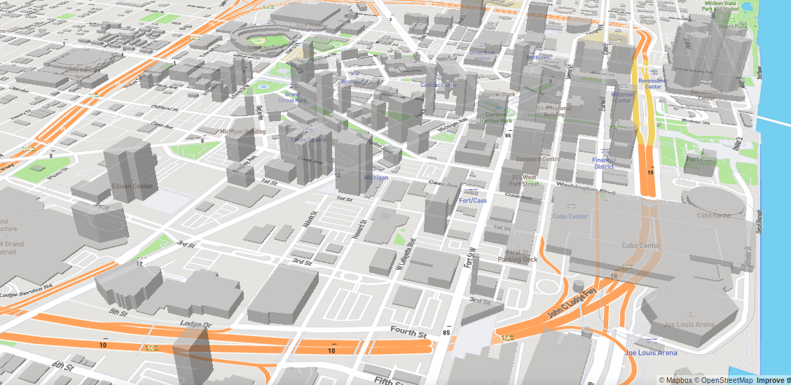
SEMCOG-UrbanSim Bi-weekly
April 9, 2019
Notes:
In this chapter, we will discuss the theoretical basis of UrbanSim at a conceptual level.
Given time constraints, we won’t be able to dive very deeply into the mathematics of the model, but if you are interested in this, at the end of this course we will point you in the direction to where you can fine more technical resources.

Slide 2
Next steps from last meeting
Finish current pass at the simple regional specifications
Calculate score for run 4036
Calculate score for run based on simple regional specifications + case study indicators (in progress)
Calculate score for run based on regional specifications + unit-level sampling in estimation + case study indicators (in progress)
Calculate score for run based on regional specifications simulated in urbansim_templates + case study indicators
Set up calibration process (in progress)
Calibrate to see how closely we can match the official forecast

Slide 3
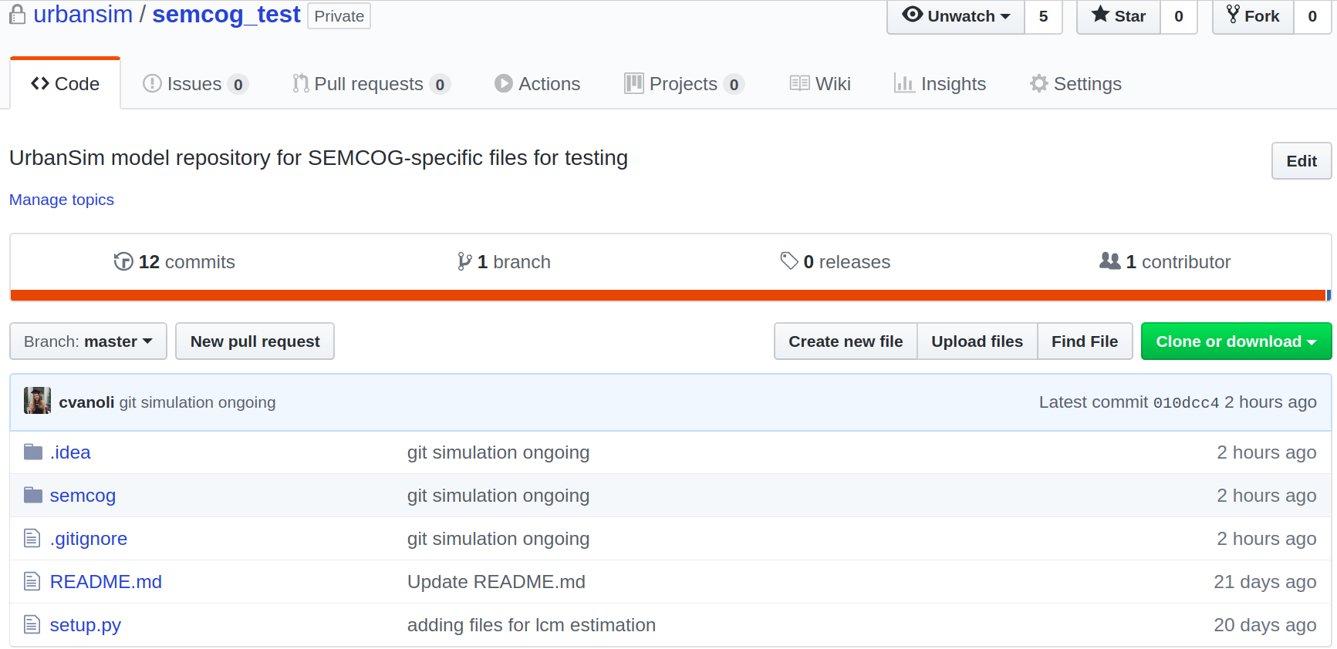

Slide 4
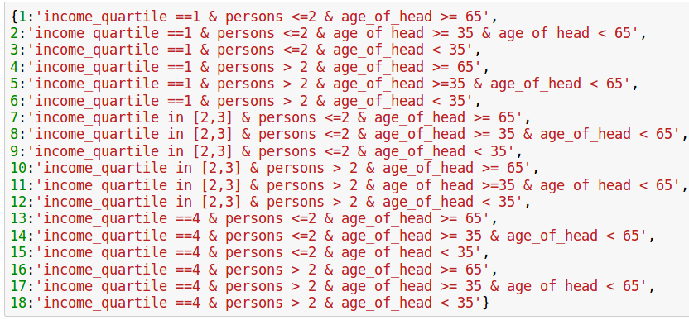
Household types

Slide 5
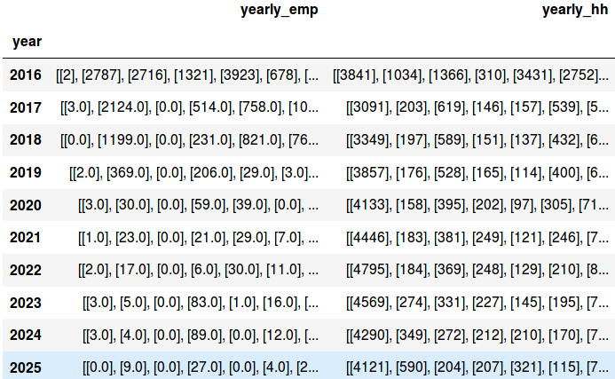
Calibrator aggregate demand input

Slide 6
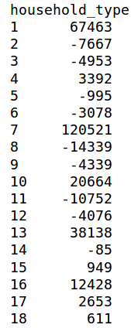
Aggregate regional change by household_type, 2015 - 2045
Low income
Middle incomes
High income

Slide 7
Aggregate regional change by household_type, 2015 - 2045
Low income
Middle incomes
High income

Slide 8
Aggregate regional change by household_type, 2015 - 2045
Low income
Segments where age_of_head >= 65
Middle incomes
High income

Slide 9
Locations where we should expect to see household growth
Locations associated with older households
Locations associated with high-income households

Slide 10
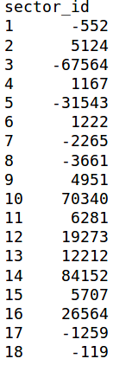
Aggregate job change by sector_id, 2015 - 2045
Growing sectors

